Slide 1
UAVSAR LITE
Steven daniels
Sprint 4

Slide 2
Sprint OBECTIVE
The goal of this sprint was to:
Calculate radar parameters for UAVSARLITE
Document important takeaways from Introduction to Airborne radar chapters 30-33
Model and Simulate IWR6843AOP antenna beamwidth

Slide 3
Sprint schedule
Design SAR system:
01/15/19-02/15/20

Slide 4
Sprint tasks
Define SAR parameters
Read “Introduction to Airborne Radar (Second Edition) by George W. Stimson
Choose a corner reflector for the SAR testing.

Slide 5
Define sar parameters
Parameters were separated into categories:
IWR6843AOP Parameters
"Introduction to Airborne Radar" parameters
IWR6843AOP USRR Chirp Configuration Parameters

Slide 6
IWR6843AOP Parameters
IWR6843AOP Parameters
Frequency |  | 60- to 64 | GHz coverage
Wavelength |  | 5 | mm | λ = C/f Where, λ (Lambda) = Wavelength in meters,c = Speed of Light (299,792,458 m/s),f = Frequency
Height of Antenna |  | 10.4 | mm
Length of Antenna |  | 10.4 | mm
Space between Antenna Elements |  | 2.5 | mm
Bandwidth |  | 4 | GHz | 4-GHz continuous bandwidth
Field Of View Azimuth |  | 130 | degrees | 130º azimuth FoV and 130º elevation FoV
Field Of View Elevation |  | 130 | degrees | 130º azimuth FoV and 130º elevation FoV
Azimuth Beamwidth(4Rx, 3Tx in Demo Visualizer) |  | 30 | degrees | https://dev.ti.com/gallery/view/mmwave/mmWave_Demo_Visualizer_IWR6843AOP/ver/1.0.0/
Elevation Beamwidth(4Rx, 3Tx in Demo Visualizer) |  | 30 | degrees | https://dev.ti.com/gallery/view/mmwave/mmWave_Demo_Visualizer_IWR6843AOP/ver/1.0.0/
Azimuth Beamwidth(4Rx, 1Tx in Demo Visualizer) |  | 60 | degrees | https://dev.ti.com/gallery/view/mmwave/mmWave_Demo_Visualizer_IWR6843AOP/ver/1.0.0/
Elevation Beamwidth(4Rx, 1Tx in Demo Visualizer) |  | 60 | degrees | https://dev.ti.com/gallery/view/mmwave/mmWave_Demo_Visualizer_IWR6843AOP/ver/1.0.0/

Slide 7
Introduction to Airborne Radar" parameters
Introduction to Airborne Radar" parameters
2-way 4dB Beamwidth(Uniformally illuminated synthetic array) |  | 0.240385 | radians | wavelength/(2*L), where L = Length of aperture | 13.77302 | degrees
2-way 3dB Beamwidth(Uniformally illuminated synthetic array) |  | 0.211538 | radians | wavelength/(2*L), where L = Length of aperture | 12.12026 | degrees
1-way 3dB Beamwidth(Uniformally illuminated real array) |  | 0.423077 | radians | 0.88(wavelength/L), where L = Length of aperture | 24.24052 | degrees
Null to Null Beamwidth(Uniformally illuminated array) |  | 0.961538 | radians | 2*(wavelength/L), where L = Length of aperture | 55.0921 | degrees
Desired Resolution Cell Size |  |  |  | see "Introduction to Airborne Radar book"
Dimension Azimuth |  | 0.20 | ft | The distance in azimuth of the side of a resolution cell
Dimension Range |  | 0.20 | ft | The distance in range of the side of a resolution cell
Ahievable Resolution Cell Size |  |  |  | see "Introduction to Airborne Radar book"
Dr |  | N/A | ft | 500* t feet where t = compressed pusle width, required bandwidth = 1/t | N/A
Da |  | 61.47541 | mm | (wavelength/2L)*R where L = array length, same units as wavelength | 0.201691 | ft
Max unambiguous range(R) |  | 22500 | mm | This value is the same as USRR Chirp Configuration Parameters max unambiguous range | 73.8189 | ft
Synthetic Array Length(L) |  | 915 | mm | This value was selected to achieve a Da of .2 ft or approx 2 inches | 3.001969 | ft
Da Min(Strip map radar) |  | 5.2 | mm | Length of Real Antenna/2, ultimate resolution for a synthetic array whose beam is positioned at a fixed angle relative to the flight path, as in strip map radars Pg. 415

Slide 8
IWR6843AOP USRR Chirp Configuration Parameters
IWR6843AOP USRR Chirp Configuration Parameters |  |  |  | USRR = Ultra Short Range Radar, take from Texas Instruments document swra553
Max unambiguous range |  | 22.5 | m
Sweep bandwidth |  | 1500 | Mhz
Ramp slope |  | 30 | MHz/us
Inter-Chirp duration |  | 50 | us
Number of chirps |  | 128 | -
Range Resolution |  | 0.1 | m | c/(2*B), where c = speed of light, and B = Sweep bandwidth of FMCW chirp Calculated using matlab
Chirp Duration |  | 50 | us
Max unambiguous relative velocity |  | 35.5 | kmph
Max beat frequency |  | 4.5 | MHz
ADC sampling rate (complex) |  | 5 | Msps
Number samples per chirp |  | 250
Range FFT size |  | 256 | -
Frame time (total) |  | 12.8 | ms
Frame time (active) |  | 6.4 | ms
Radar data memory required |  | 512 | KB | For 1 radar data cube

Slide 9
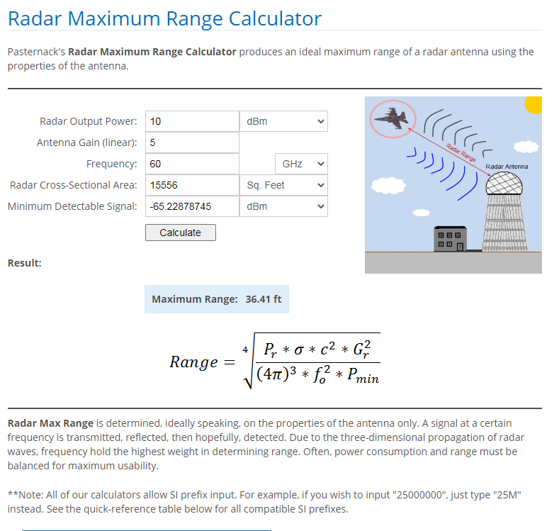
Radar range equation

Slide 10
Read “Introduction to Airborne Radar (Second Edition) by George W. Stimson
Completed chapters: 1,2,3,12,13,30,31,32,33
Important takeaways chapters 1-3
Important takeaways chapters 12-13
Important takeaways chapters 30-33

Slide 11
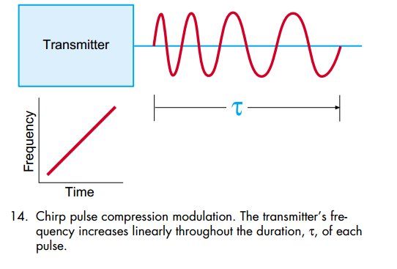
Important takeaways chapters 1-3

Slide 12
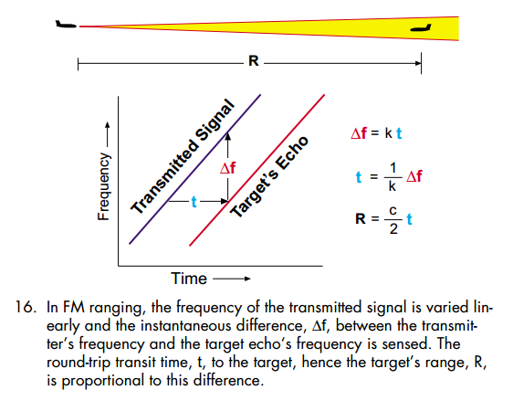
Important takeaways chapters 1-3

Slide 13
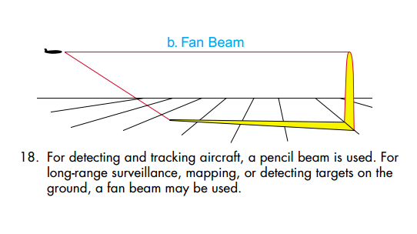
Important takeaways chapters 1-3

Slide 14
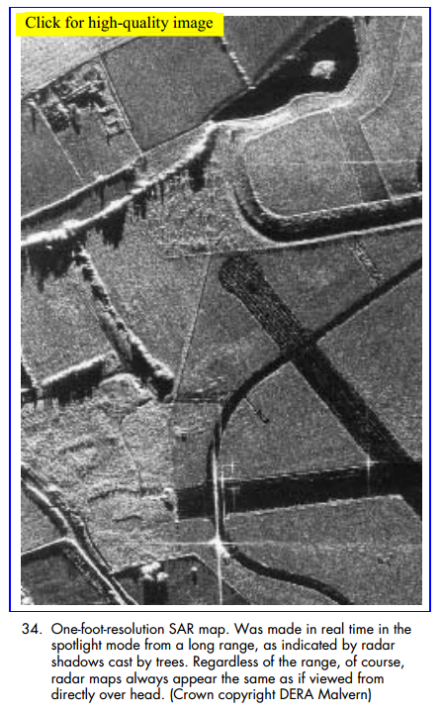
Important takeaways chapters 1-3
Since radio waves are scattered in different amounts by different features of the terrain, a radar can map the ground. With SAR, detailed maps can be made.

Slide 15
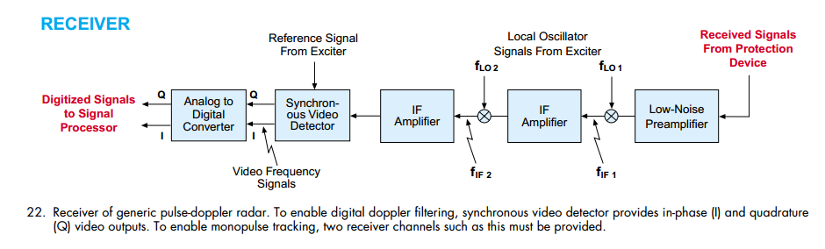
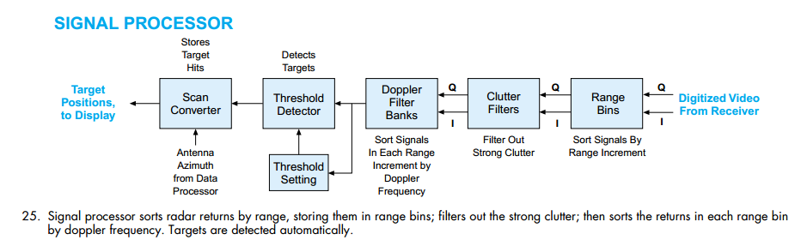
Important takeaways chapters 1-3

Slide 16
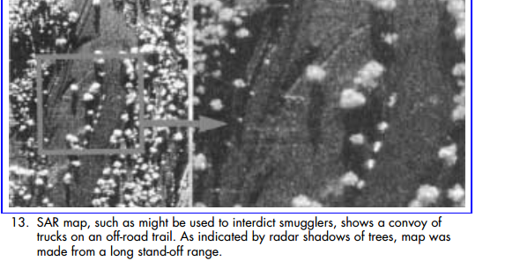
Important takeaways chapters 1-3
Law Enforcement. Both SLAR and SAR have played important roles in oil-spill detection, fishery protection, and the interdiction of smugglers and drug traffickers. Since SAR can provide fine resolution at long ranges, it has the advantage of uncovering illicit activities without alerting the law breakers (Fig. 13).

Slide 17
Important takeaways chapters 12-13
Law Enforcement. Both SLAR and SAR have played important roles in oil-spill detection, fishery protection, and the interdiction of smugglers and drug traffickers. Since SAR can provide fine resolution at long ranges, it has the advantage of uncovering illicit activities without alerting the law breakers (Fig. 13).

Slide 18
Choosing a corner reflector
A corner reflector is a passive device used to reflect radio waves back toward the transmit source. Therefore, the corner reflector is a useful device for radar system calibration and testing. The corner reflector is made of intersected perpendicular plates. The most common type of corner reflectors are dihedral and trihedral.
The dihedral corner reflectors can be sensitive to its mechanical alignment so more can issues can occur while the trihedral corner reflect is much more tolerant to being misaligned. This offers an easy way for quick field setup and calibration when needed.

Slide 19
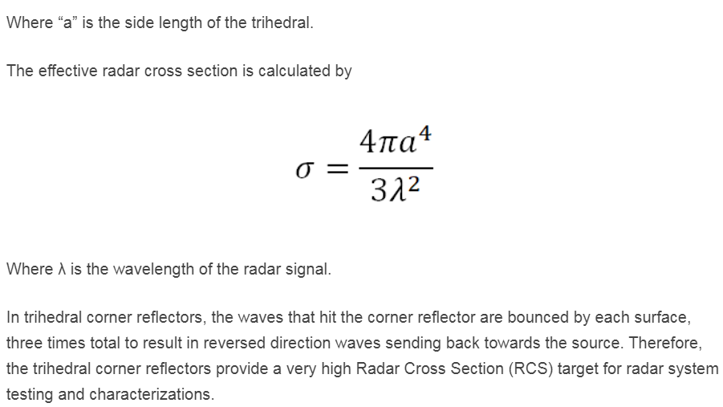
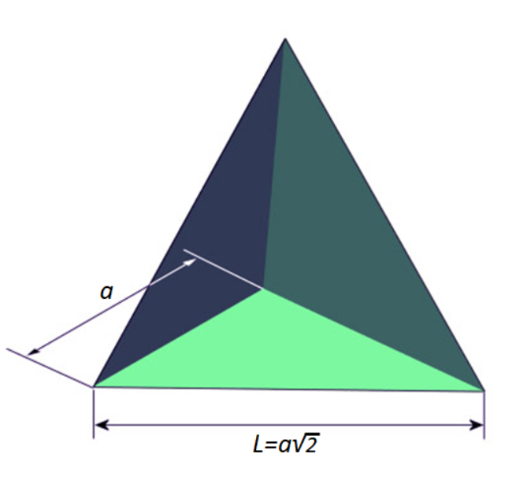
Choosing a corner reflector
A trihedral corner reflector was chosen for this experiment. The trihedral corner reflector is made from three right angles which is illustrated in the image below.

Slide 20
Antenna
An individual microstrip antenna consists of a patch of metal foil of various shapes (a patch antenna) on the surface of a PCB (printed circuit board), with a metal foil ground plane on the other side of the board. Most microstrip antennas consist of multiple patches in a two-dimensional array.
The most common type of microstrip antenna is the patch antenna.A patch antenna is a narrowband, wide-beam antenna fabricated by etching the antenna element pattern in metal trace bonded to an insulating dielectric substrate, such as a printed circuit board, with a continuous metal layer bonded to the opposite side of the substrate which forms a ground plane.

Slide 21
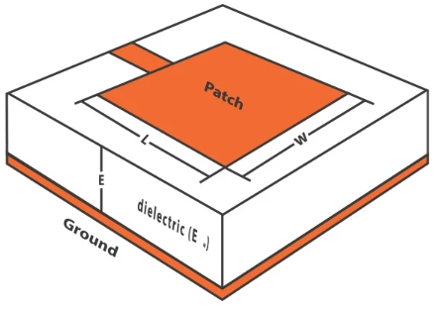
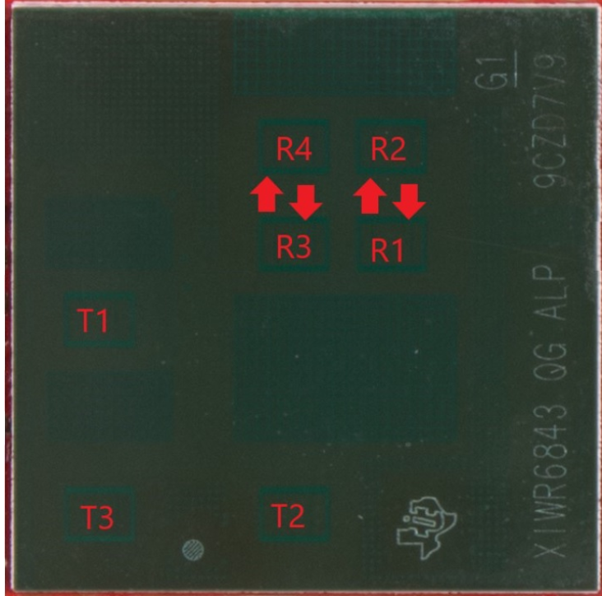
Microstrip patch antenna

Slide 22

IWR6843AOPEVM antenna
The IWR6843AOPEVM as the name implies includes four receivers and three transmitter wide field of antennas on the package of the device. The IWR6843 operates at 4-Ghz bandwidth from 60 to 64 GHz, with a maximum output power of 10 dBm; the IWR6843AOPEVM has an antenna gain of ~6 dBi.

Slide 23
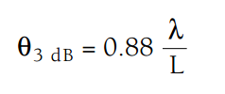
beamwidth
The 3 dB, or half power, beamwidth of the antenna is defined as the angular width of the radiation pattern, including beam peak maximum, between points 3 dB down from maximum beam level (beam peak).
3-dB Beamwidth can be calculated with the formula:
IWR6843AOP:
Azimuth FOV (deg) +/- 60
Elevation FOV (deg) +/- 60
Gain 5dBi
4 Rx,1 Tx creates a Az FoV (deg) 60 & Elev FoV(deg) 60 for a combined FoV(deg) 120

Slide 24
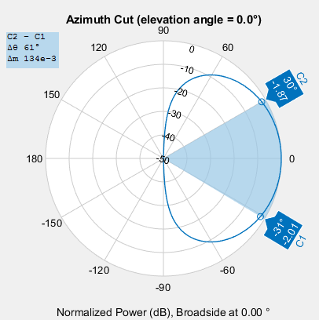
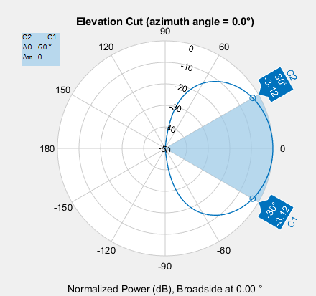
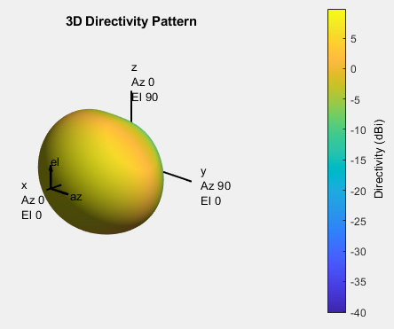
beamwidth

Slide 25
retrospective

